Slide 1

Rikuhei Umemoto and Keisuke Fujii
Evaluation of Team Defense Positioning by Computing Counterfactuals using StatsBomb 360 data
Notes:
Hello, everyone.
I'm Rikuhei Umemoto a Master Student at Nagoya University.
Today, I want to discuss Evaluation of Team Defense Positioning by Computing Counterfactuals using StatsBomb 360 data.
slow down a little

Slide 2
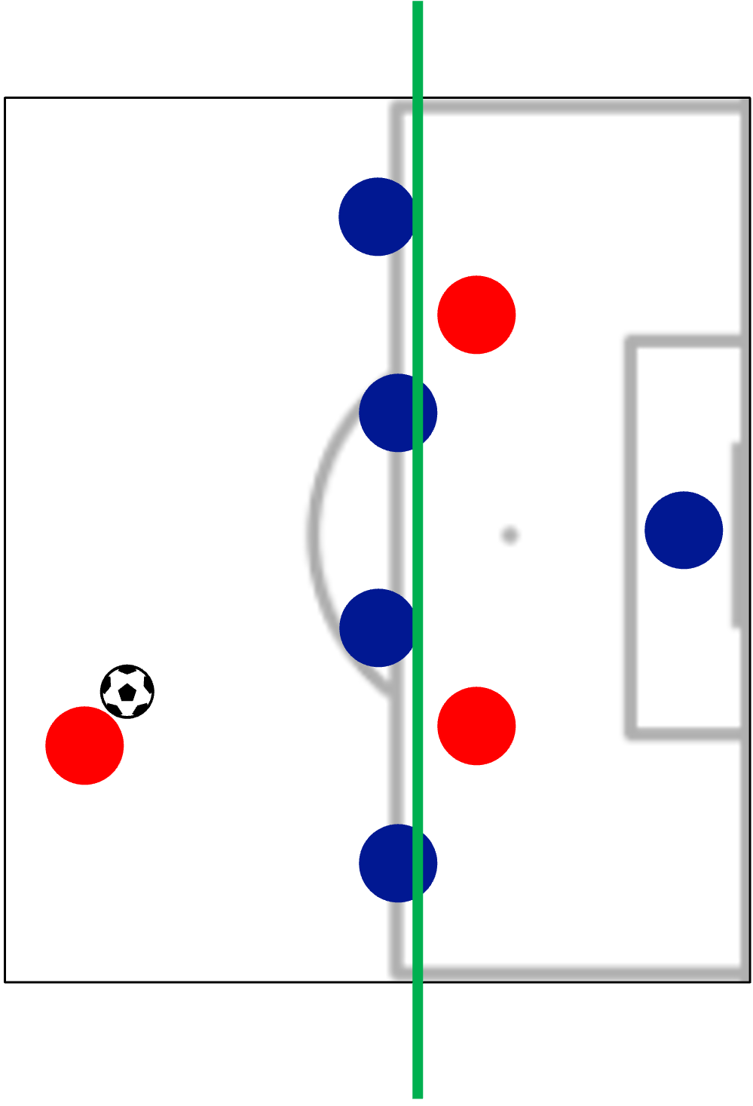
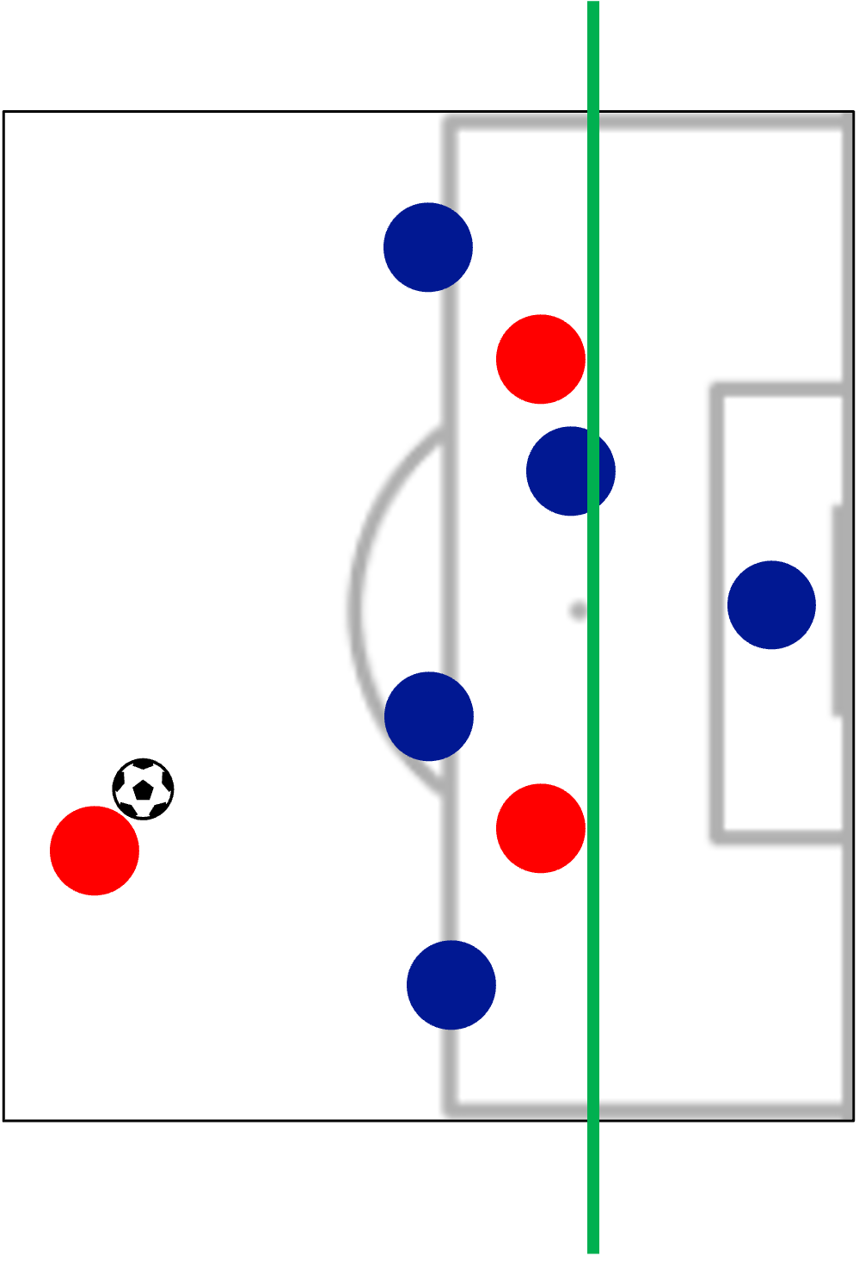
Introduction
What should your team have done during defense in football?
OK
Danger
Attacker
Defender
Offside line
OK
Danger
Search for optimal positioning during defense and its evaluation.
Notes:
First, I would like to ask you all.
"What should your team have done during defense in football?"
This question is one of the most important for team players and coaches in your team.
As an example, please look at the following figures.
These are figures of defenders' positionings where the on-ball player is looking for a passer.
With the positioning in the figure on the left, we can see that the two attackers are offside and unlikely to score.
However, with the positioning on the right, we can see that the two attackers are onside and have a high chance of scoring.
In other words, this difference in their positions can significantly affect your team's situation, so finding and evaluating the most suitable position is necessary.

Slide 3

Related Work
Off-ball performance analysis.
For attackers: OBSO[1], C-OBSO[2], positioning value[3] etc.
For defenders: VDEP[4], prediction of offensive play[5] etc.
Use complete location data
-> Develop a method that can apply these to incomplete location data.
Performance analysis with incomplete location data.
For attackers: un-xPass[6], line breaking pass[7] etc.
For defenders: GVDEP[8], ball recovery[9]
Very few for defenders
-> Develop another method to evaluate team defense to the evaluation method of attackers.
Notes:
Off-ball performance analysis includes the followings.
I'll explain OBSO, on which this study is based, later.
However, all of these need expensive data containing positional information on all players.
It is unclear if we used this when the positional data of the players is incomplete, as is the case with many open data.
Therefore, we must develop a method to apply such techniques to incomplete location data.
Several performance evaluation methods use this incomplete player location data.
However, about defenders, the methods are limited because defensive events are more difficult to define than attacking events.
Therefore, it is necessary to develop another method to evaluate team defense by applying the evaluation method of attackers.

Slide 4
Proposed Methodology
EF-OBSO (Event and Freeze frame based OBSO)
A method to allow OBSO to be calculated even with incomplete data
DRSO (Defensive Response to Scoring Opportunities)
A method to apply EF-OBSO to evaluations of defenders’ optimal positionings using counterfactuals.
Everyone can easily calculate OBSO and evaluate football tactics.
Notes:
With these objectives, we propose the following methodologies.
One is EF-OBSO (Event and Freeze Frame based OBSO).
This method allows OBSO to be calculated even with incomplete player location data by considering more critical situations in football.
The second is DRSO (Defense Response to Scoring Opportunities).
This method uses the EF-OBSO described above to search for the defenders' optimal positioning by using counterfactuals.
These methodologies will make it possible to calculate OBSO with any data and enable everyone to analyze football tactics.

Slide 5

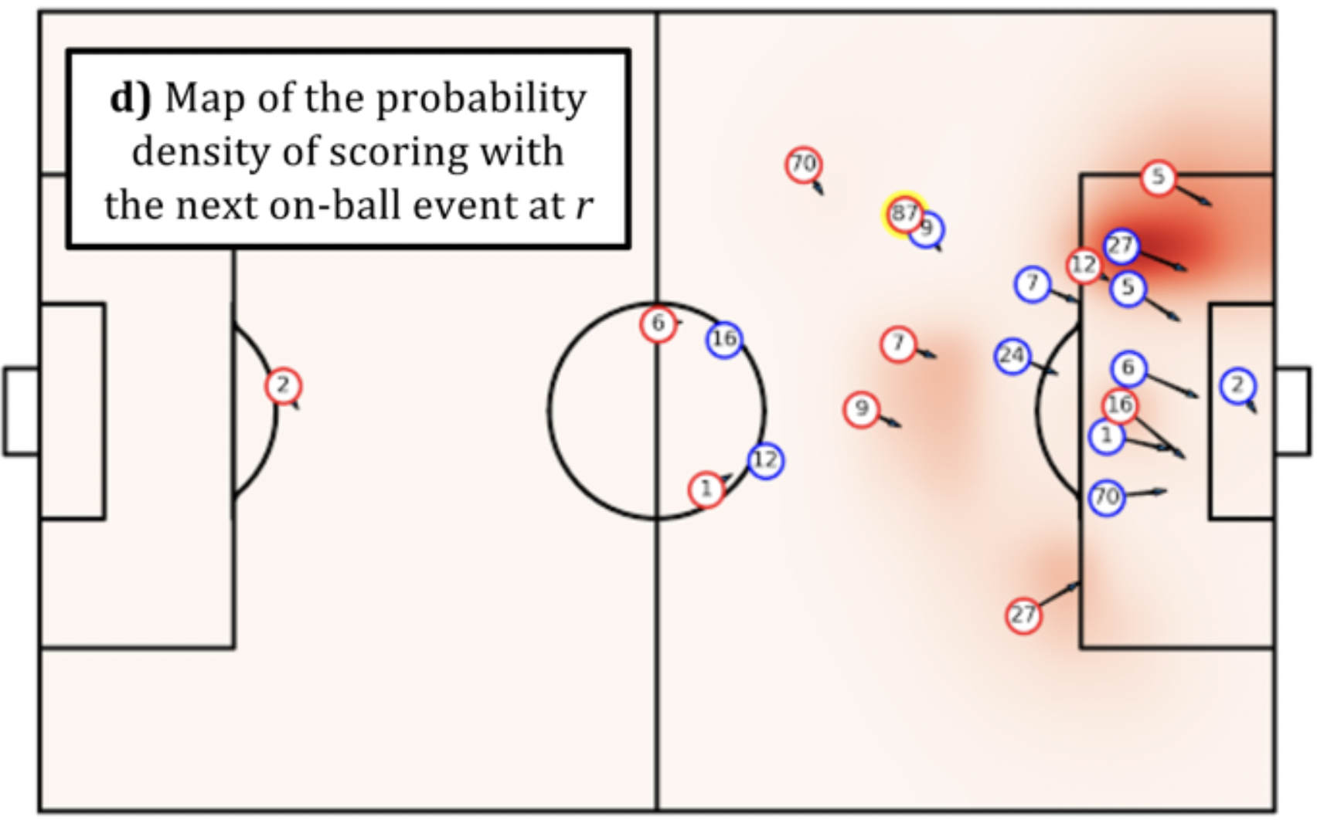
OBSO
To express the probability of whether an off-ball player can score a goal in the next state.
Evaluate off-ball attackers.
Able to interpret the model.
Predict scores using all players information.
Only for complete location data.
Only for attackers.
Only for what actually happened.
Example of OBSO model: probability density of scoring with the next on-ball event at the specified location (cited by [1])
This Image is placeholder. Click > Replace Image
Notes:
Incidentally, what is OBSO?
OBSO (Off-Ball Scoring Opportunity) is a method to express the probability of whether an off-ball player can score a goal in the next event.
In the figure on the right, from Spearman’s paper shows the range of probabilities in dark red.
The advantage is that we can evaluate off-ball attackers, interpret this model, and predict a score using all players' information.
However, the disadvantages for this model is only for complete location data, only for attackers, and only for what occurred.

Slide 6
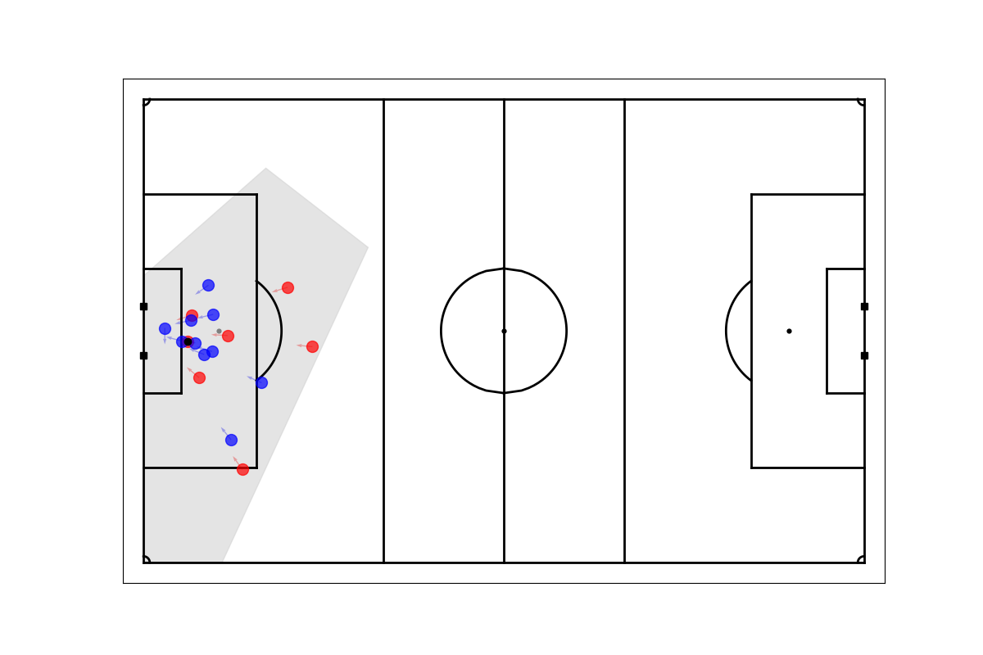
EF-OBSO
To calculate OBSO even with event and freeze frame data
location data without coordinates for some players and velocities for all players
Solution: Only for events in the attacking third.
Advantages
Consider information on more players.
(especially the defensive goalkeeper)
Fix players’ velocity vectors.
Consider dangerous situations for defenders.
Attacking third
Attacker
Defender
Visible area
Toward the goal
Notes:
Therefore, we propose EF-OBSO.
This methodology calculates OBSO even with the event and freeze frame data, including location data without coordinates for some players and velocities for all players.
The critical solution is only calculating OBSO for events in the attacking third.
This solution has three advantages.
First, we can consider information on more players, especially a defensive goalkeeper.
In freeze frame data based on broadcast videos, we can consider still scenes near the goal to show more players than other stills, and offside events as the defending goalkeeper was often in the still.
The second is that we can fix players' velocity vectors.
When defending in the attacking third, most players are aware of the direction of the goal so that we can set the vectors towards the goal.
Thus, the attacking third is an area of increased scoring opportunities for attackers and we can consider dangerous situations for defenders, due to the increased conceding opportunities for defenders, so it is essential to focus on this area.

Slide 7
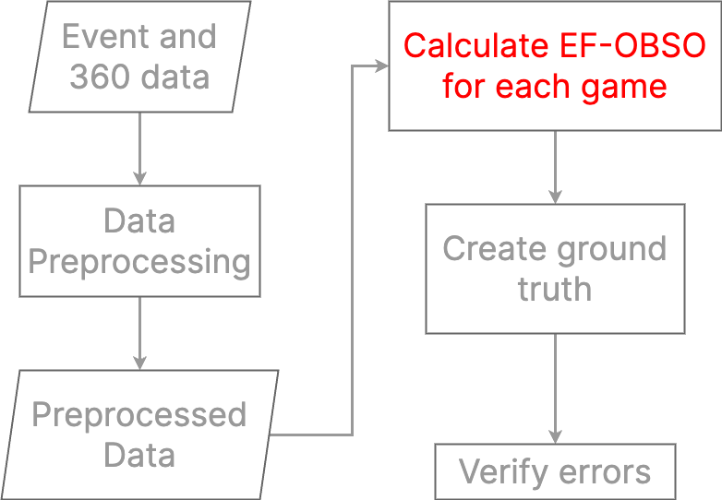
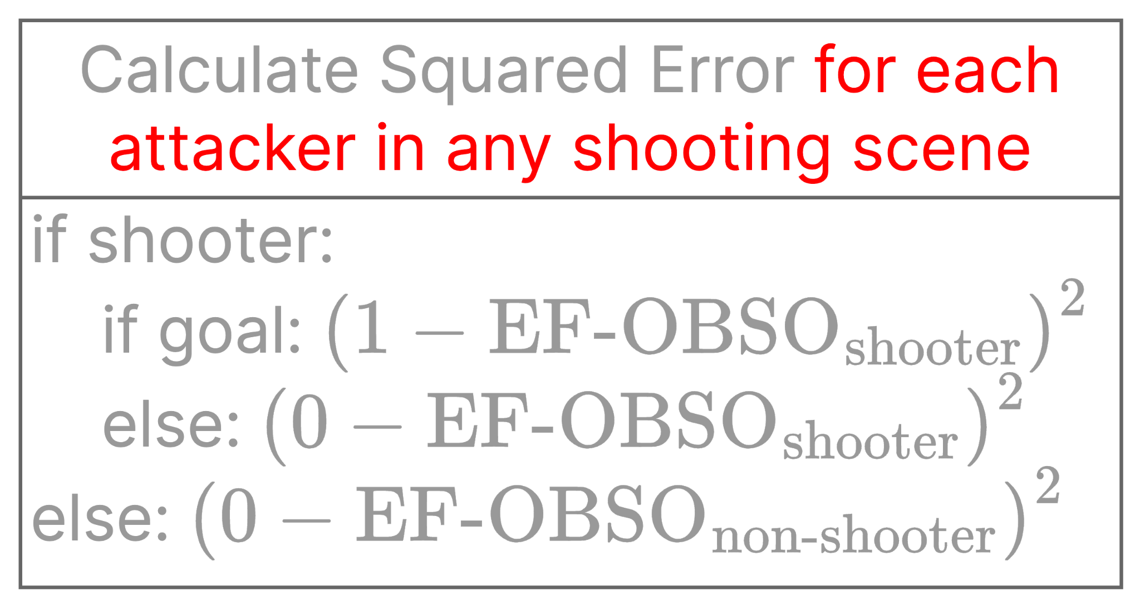
Flow of calculation and verification of EF-OBSO
Notes:
Now describing the calculation and verification method for EF-OBSO with the flow in the diagram on the left.
First, EF-OBSO was calculated for each game using the pre-processed event and 360 data.
After this calculation, we created the ground truth and calculated squared errors.
First, we restricted the verification scenes to shooting scenes.
This is because OBSO is a quantitative representation of the scoring opportunities, and so EF-OBSO based on this.
Next, we judged whether the player was a shooter.
We set the ground truth for shooters to 1 or 0, depending on whether the still was a goal.
For other attackers, we set the ground truth to 0.

Slide 8
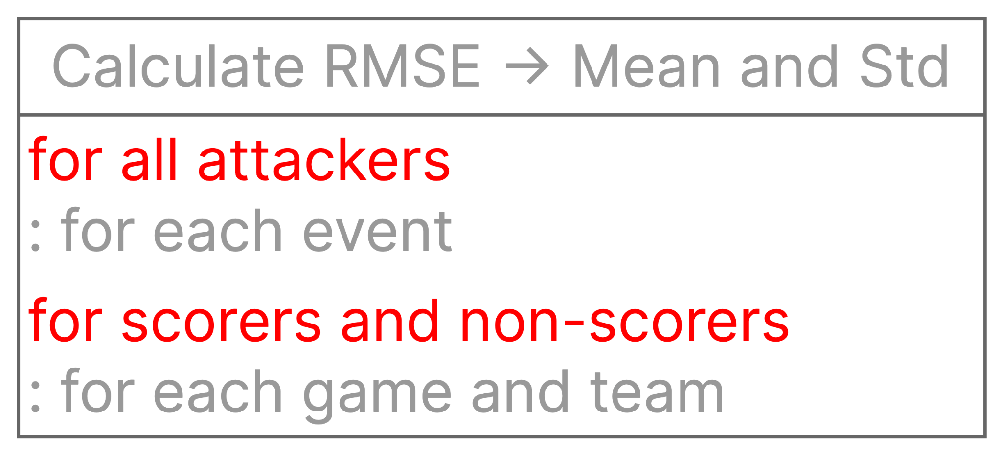
Flow of calculation and verification of EF-OBSO
Only 180 games played home and away by each of the following 10 teams were verified and evaluated.
Arsenal, Brentford, Brighton & Hove Albion, Chelsea, Everton, Leeds United, Liverpool, Manchester City, Manchester United, Tottenham Hotspur.
Notes:
We used the squared error for each player to calculate RMSE.
First, for all attackers, we calculated the RMSE for each shooting event and the mean and standard deviation of this indicator by the number of shooting events.
Second, concerning shooters only, we verified RMSE for scorers and non-scorers.
Specifically, we first calculated this for each team and the mean and standard deviation by the number of teams.
In this study, the teams used in the verification were the ten teams listed above.
Next, we calculated this for each game and the statisitcs by the number of games, which was 180 games.

Slide 9
Flow of calculation and verification of EF-OBSO
Speed conditions to be verified.
All players = 0.0[m/s],
(Assumed the actor and defensive GK’s speed was varied depending on the event,)
all other players =
0.0[m/s],
4.0[m/s],
4.5[m/s],
5.0[m/s].
Notes:
I carried out this verification for the speed of all players.
When calculating OBSO, we need to use the speeds which was not available in the data.
Therefore, I verified the speeds and set the conditions on the right.
First, the speed of all players is 0.0 [m/s].
Next, varying the speed of the actor and the defending goalkeeper according to the event, we set the speed of the other players to 0.0, 4.0, 4.5, and 5.0 [m/s].

Slide 10
Verification Result
 | All attackers |  | scorers |  |  |  | non-scorers
 | All attackers |  | teams |  | games |  | teams |  | games
(Unit: m/s) | Mean (10⁻¹) | Std (10⁻¹) | Mean (10⁻¹) | Std (10⁻²) | Mean (10⁻¹) | Std (10⁻²) | Mean (10⁻¹) | Std (10⁻³) | Mean (10⁻¹) | Std (10⁻²)
Ⅰ. All 0.0 | 1.246 | 1.171 | 8.456 | 1.096 | 8.424 | 6.723 | 1.214 | 5.598 | 1.192 | 2.076
(Fixing speeds of actor and defensive GK, other players’ speeds were)
Ⅱ. 0.0 | 1.245 | 1.172 | 8.472 | 1.232 | 8.445 | 5.420 | 1.200 | 5.420 | 1.181 | 1.978
Ⅲ. 4.0 | 1.196 | 1.153 | 8.330 | 1.032 | 8.300 | 5.864 | 1.340 | 6.678 | 1.320 | 1.955
Ⅳ. 4.5 | 1.190 | 1.150 | 8.303 | 1.057 | 8.269 | 5.990 | 1.365 | 6.853 | 1.344 | 1.985
Ⅴ. 5.0 | 1.186 | 1.147 | 8.276 | 1.097 | 8.236 | 6.190 | 1.389 | 6.978 | 1.368 | 2.019
Notes:
Verification result.

Slide 11
Verification Result
 | All attackers |  | scorers |  |  |  | non-scorers
 | All attackers |  | teams |  | games |  | teams |  | games
(Unit: m/s) | Mean (10⁻¹) | Std (10⁻¹) | Mean (10⁻¹) | Std (10⁻²) | Mean (10⁻¹) | Std (10⁻²) | Mean (10⁻¹) | Std (10⁻³) | Mean (10⁻¹) | Std (10⁻²)
Ⅰ. All 0.0 | 1.246 | 1.171 | 8.456 | 1.096 | 8.424 | 6.723 | 1.214 | 5.598 | 1.192 | 2.076
(Fixing speeds of actor and defensive GK, other players’ speeds were)
Ⅱ. 0.0 | 1.245 | 1.172 | 8.472 | 1.232 | 8.445 | 5.420 | 1.200 | 5.420 | 1.181 | 1.978
Ⅲ. 4.0 | 1.196 | 1.153 | 8.330 | 1.032 | 8.300 | 5.864 | 1.340 | 6.678 | 1.320 | 1.955
Ⅳ. 4.5 | 1.190 | 1.150 | 8.303 | 1.057 | 8.269 | 5.990 | 1.365 | 6.853 | 1.344 | 1.985
Ⅴ. 5.0 | 1.186 | 1.147 | 8.276 | 1.097 | 8.236 | 6.190 | 1.389 | 6.978 | 1.368 | 2.019
For All attackers and scorers: Condition 5 was the best
Notes:
Condition 5 was the best for all attackers and scorers,

Slide 12
Verification Result
 | All attackers |  | scorers |  |  |  | non-scorers
 | All attackers |  | teams |  | games |  | teams |  | games
(Unit: m/s) | Mean (10⁻¹) | Std (10⁻¹) | Mean (10⁻¹) | Std (10⁻²) | Mean (10⁻¹) | Std (10⁻²) | Mean (10⁻¹) | Std (10⁻³) | Mean (10⁻¹) | Std (10⁻²)
Ⅰ. All 0.0 | 1.246 | 1.171 | 8.456 | 1.096 | 8.424 | 6.723 | 1.214 | 5.598 | 1.192 | 2.076
(Fixing speeds of actor and defensive GK, other players’ speeds were)
Ⅱ. 0.0 | 1.245 | 1.172 | 8.472 | 1.232 | 8.445 | 5.420 | 1.200 | 5.420 | 1.181 | 1.978
Ⅲ. 4.0 | 1.196 | 1.153 | 8.330 | 1.032 | 8.300 | 5.864 | 1.340 | 6.678 | 1.320 | 1.955
Ⅳ. 4.5 | 1.190 | 1.150 | 8.303 | 1.057 | 8.269 | 5.990 | 1.365 | 6.853 | 1.344 | 1.985
Ⅴ. 5.0 | 1.186 | 1.147 | 8.276 | 1.097 | 8.236 | 6.190 | 1.389 | 6.978 | 1.368 | 2.019
For non-corers: Condition 2 was the best
Notes:
while condition 2 was the best for non-scorers.

Slide 13
Verification Result
 | All attackers |  | scorers |  |  |  | non-scorers
 | All attackers |  | teams |  | games |  | teams |  | games
(Unit: m/s) | Mean (10⁻¹) | Std (10⁻¹) | Mean (10⁻¹) | Std (10⁻²) | Mean (10⁻¹) | Std (10⁻²) | Mean (10⁻¹) | Std (10⁻³) | Mean (10⁻¹) | Std (10⁻²)
Ⅰ. All 0.0 | 1.246 | 1.171 | 8.456 | 1.096 | 8.424 | 6.723 | 1.214 | 5.598 | 1.192 | 2.076
(Fixing speeds of actor and defensive GK, other players’ speeds were)
Ⅱ. 0.0 | 1.245 | 1.172 | 8.472 | 1.232 | 8.445 | 5.420 | 1.200 | 5.420 | 1.181 | 1.978
Ⅲ. 4.0 | 1.196 | 1.153 | 8.330 | 1.032 | 8.300 | 5.864 | 1.340 | 6.678 | 1.320 | 1.955
Ⅳ. 4.5 | 1.190 | 1.150 | 8.303 | 1.057 | 8.269 | 5.990 | 1.365 | 6.853 | 1.344 | 1.985
Ⅴ. 5.0 | 1.186 | 1.147 | 8.276 | 1.097 | 8.236 | 6.190 | 1.389 | 6.978 | 1.368 | 2.019
For All attackers and scorers: Condition 5 was the best
Notes:
Since the RMSE of all attackers was the lowest, we calculated DRSO under condition 5; the speed of the actors and the defending goalkeeper varied depending on the event, as we set the speeds of the other players at 5.0 [m/s].

Slide 14
DRSO
To evaluate defenders’ positionings with EF-OBSO using counterfactuals.
Solution: Find a grid vertice where a defender would have reduced the max EF-OBSO.
Advantages
Understand the optimal positioning for each defender.
Able to to interpret the model (because based on OBSO)
Notes:
The following section introduces the DRSO method.
This method is to evaluate defenders' positions with EF-OBSO using counterfactuals.
Our solution to this is that we found a lattice point where a defender would have reduced the max EF-OBSO.
This method's advantages are that we can understand the optimal positioning for each defender and interpret the model based on OBSO.

Slide 15
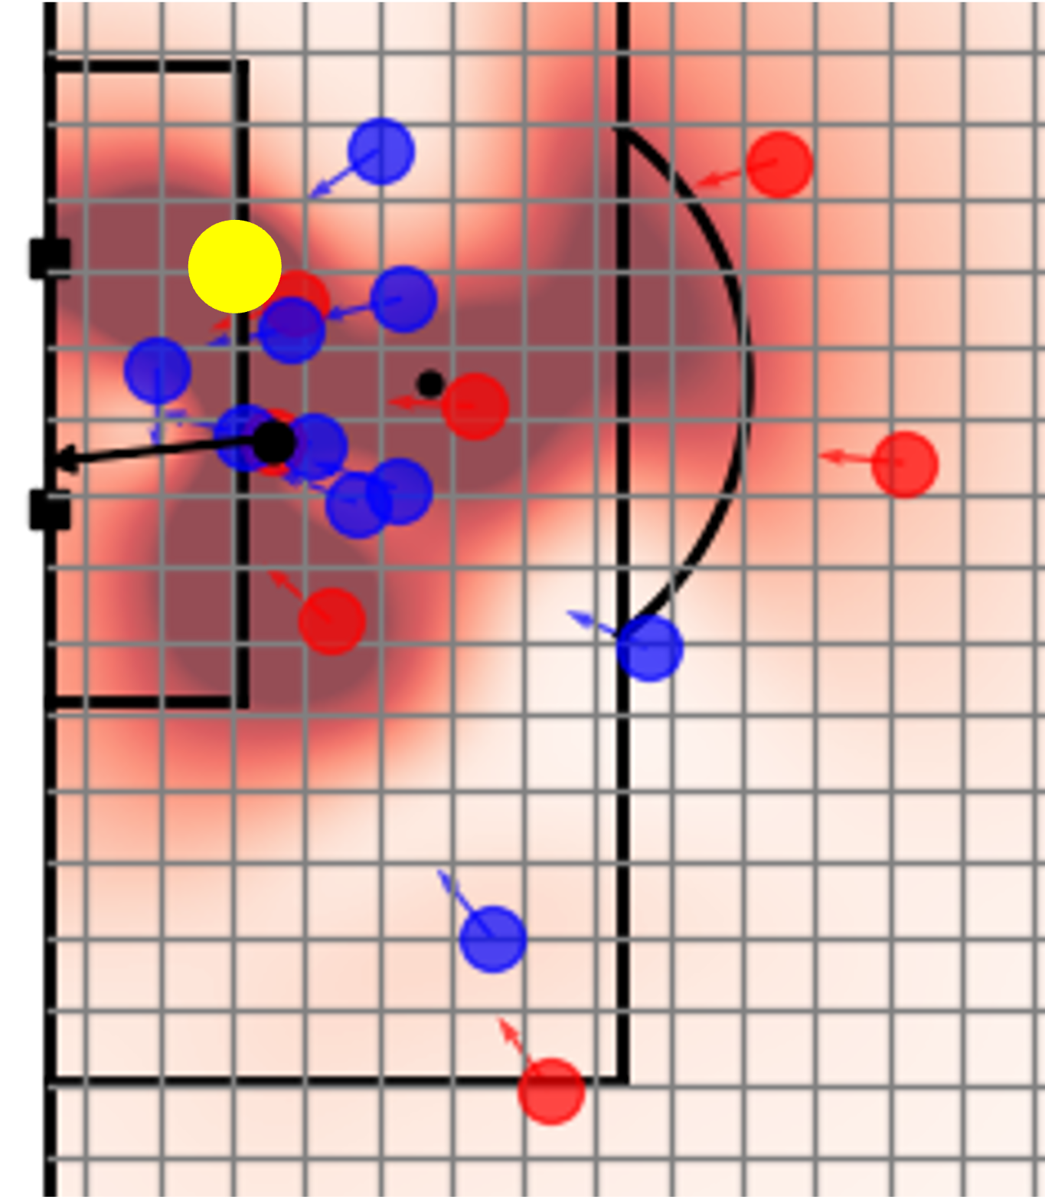
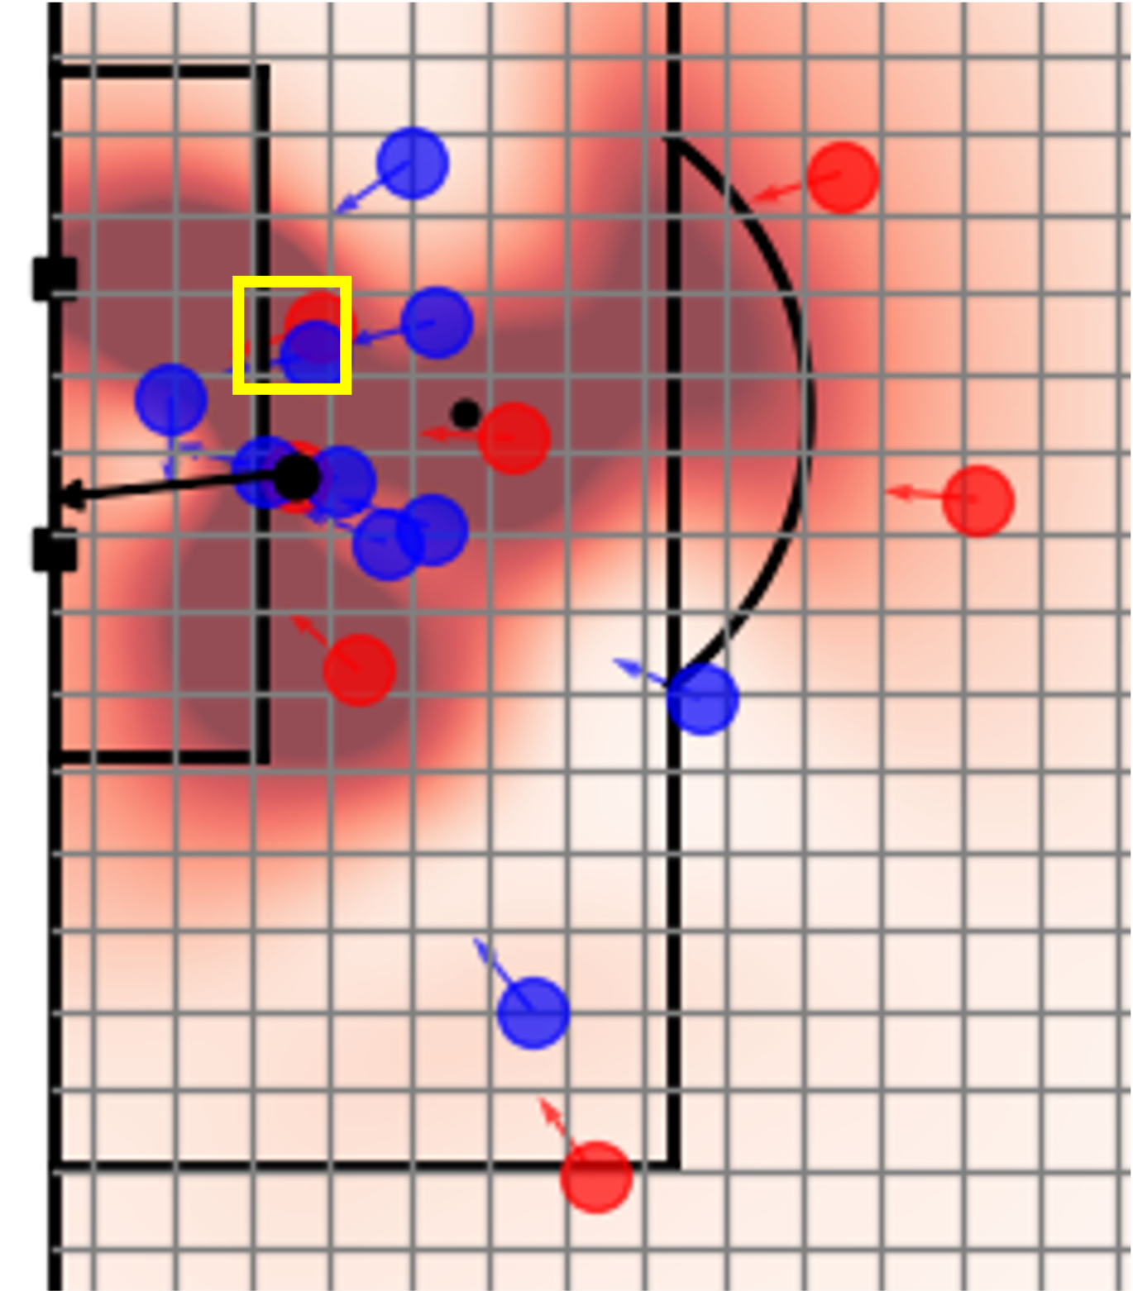
The algorithm of DRSO (1/4)
Solution: Find a grid vertice where a defender would have reduced the max EF-OBSO.
Extract the closest defender to the point of maximum EF-OBSO value and the grid where this defender was.
The point of maximum EF-OBSO
Attacker
Defender
The grid where the defender was
The closest defender
Notes:
To explain the DRSO algorithm, first, I extracted the closest defender to the point of maximum EF-OBSO value and the grid where this defender was.

Slide 16
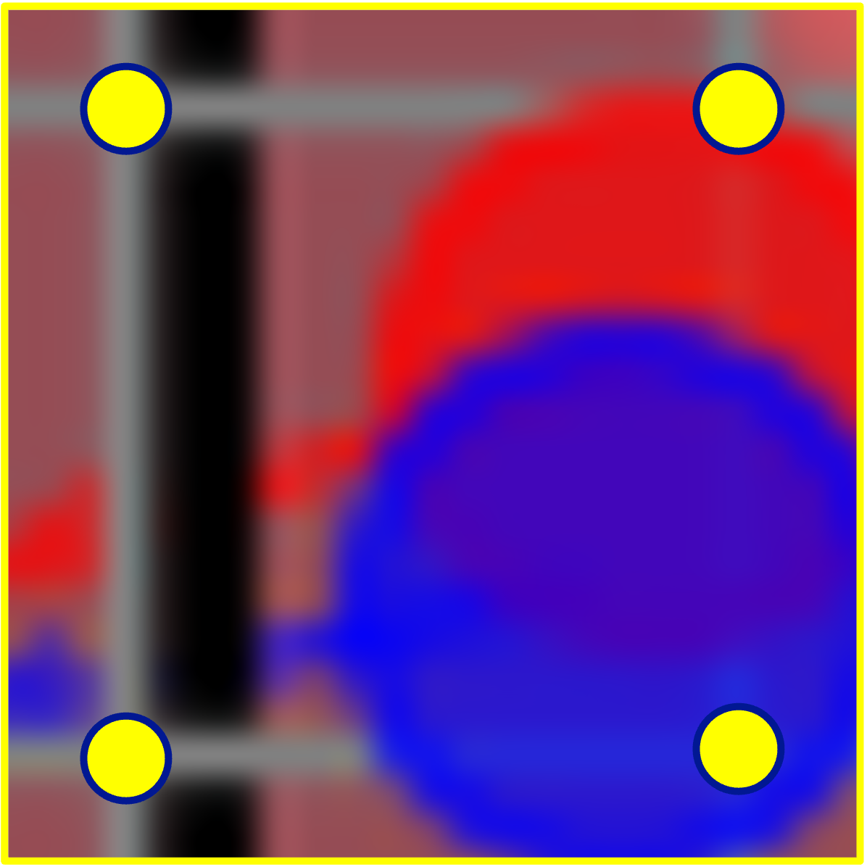
The algorithm of DRSO (2/4)
Solution: Find a grid vertice where a defender would have reduced the max EF-OBSO.
For each of the 4 vertices of this grid, assume that the defender would have been.
Under the assumption, calculate EF-OBSO and its maximum values for each point.
Max: 0.109
Max: 0.157
Max: 0.113
Max: 0.146
Notes:
Second, I assumed where the defender would have been for each of the four lattice points of this grid.
Third, I calculated EF-OBSO and its maximum values for each point under this assumption.

Slide 17
The algorithm of DRSO (3/4)
Solution: Find a grid vertice where a defender would have reduced the max EF-OBSO.
Consider the point that took the smallest of the 4 and the original value as the defender’s optimal position.
(For evaluation) take the difference between that minimum value and the original one.
(In this case, the difference Diff = 0.109 - 0.133 = -0.024.)
Max: 0.109
Max: 0.157
Optimal Positioning
(Original) Max: 0.133
Max: 0.113
Max: 0.146
Notes:
Fourth, I considered the point that took the lowest value of the four and the original value as the defender's optimal position.
Fifth, I evaluated the difference between that minimum value and the original one.
Here, Diff is defined as that minimum value minus the original one.
In this case, the difference Diff is equal to -0.024.

Slide 18
The algorithm of DRSO (4/4)
Solution: Find a grid vertice where a defender would have reduced the max EF-OBSO.
Perform these operations also on the second and third closest defenders to the point of the maximum EF-OBSO.
(For evaluation) average the difference calculated with respect to the three defenders.
The point of maximum EF-OBSO
The third closest defender
The second closest defender
Notes:
Sixth, I performed these operations on the second and third closest defenders to the point of the maximum EF-OBSO.
Here, the reason for setting three people is calculation time.
However, note that we can apply this method to many defenders.
Seventh, I averaged the difference Diff calculated concerning the three defenders for evaluation.

Slide 19
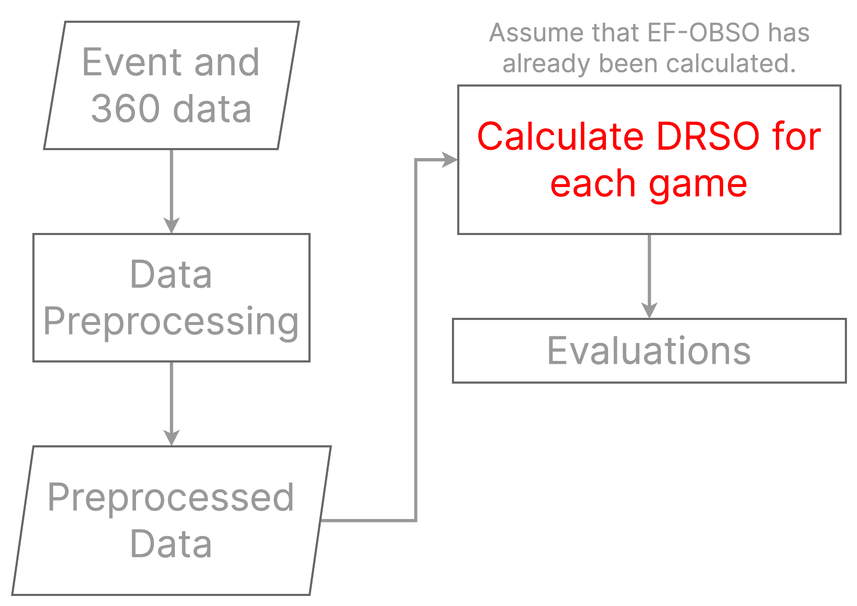
Flowchart of evaluation of team defense with DRSO
Notes:
The diagram shows the flow of evaluating team defense using DRSO.

Slide 20
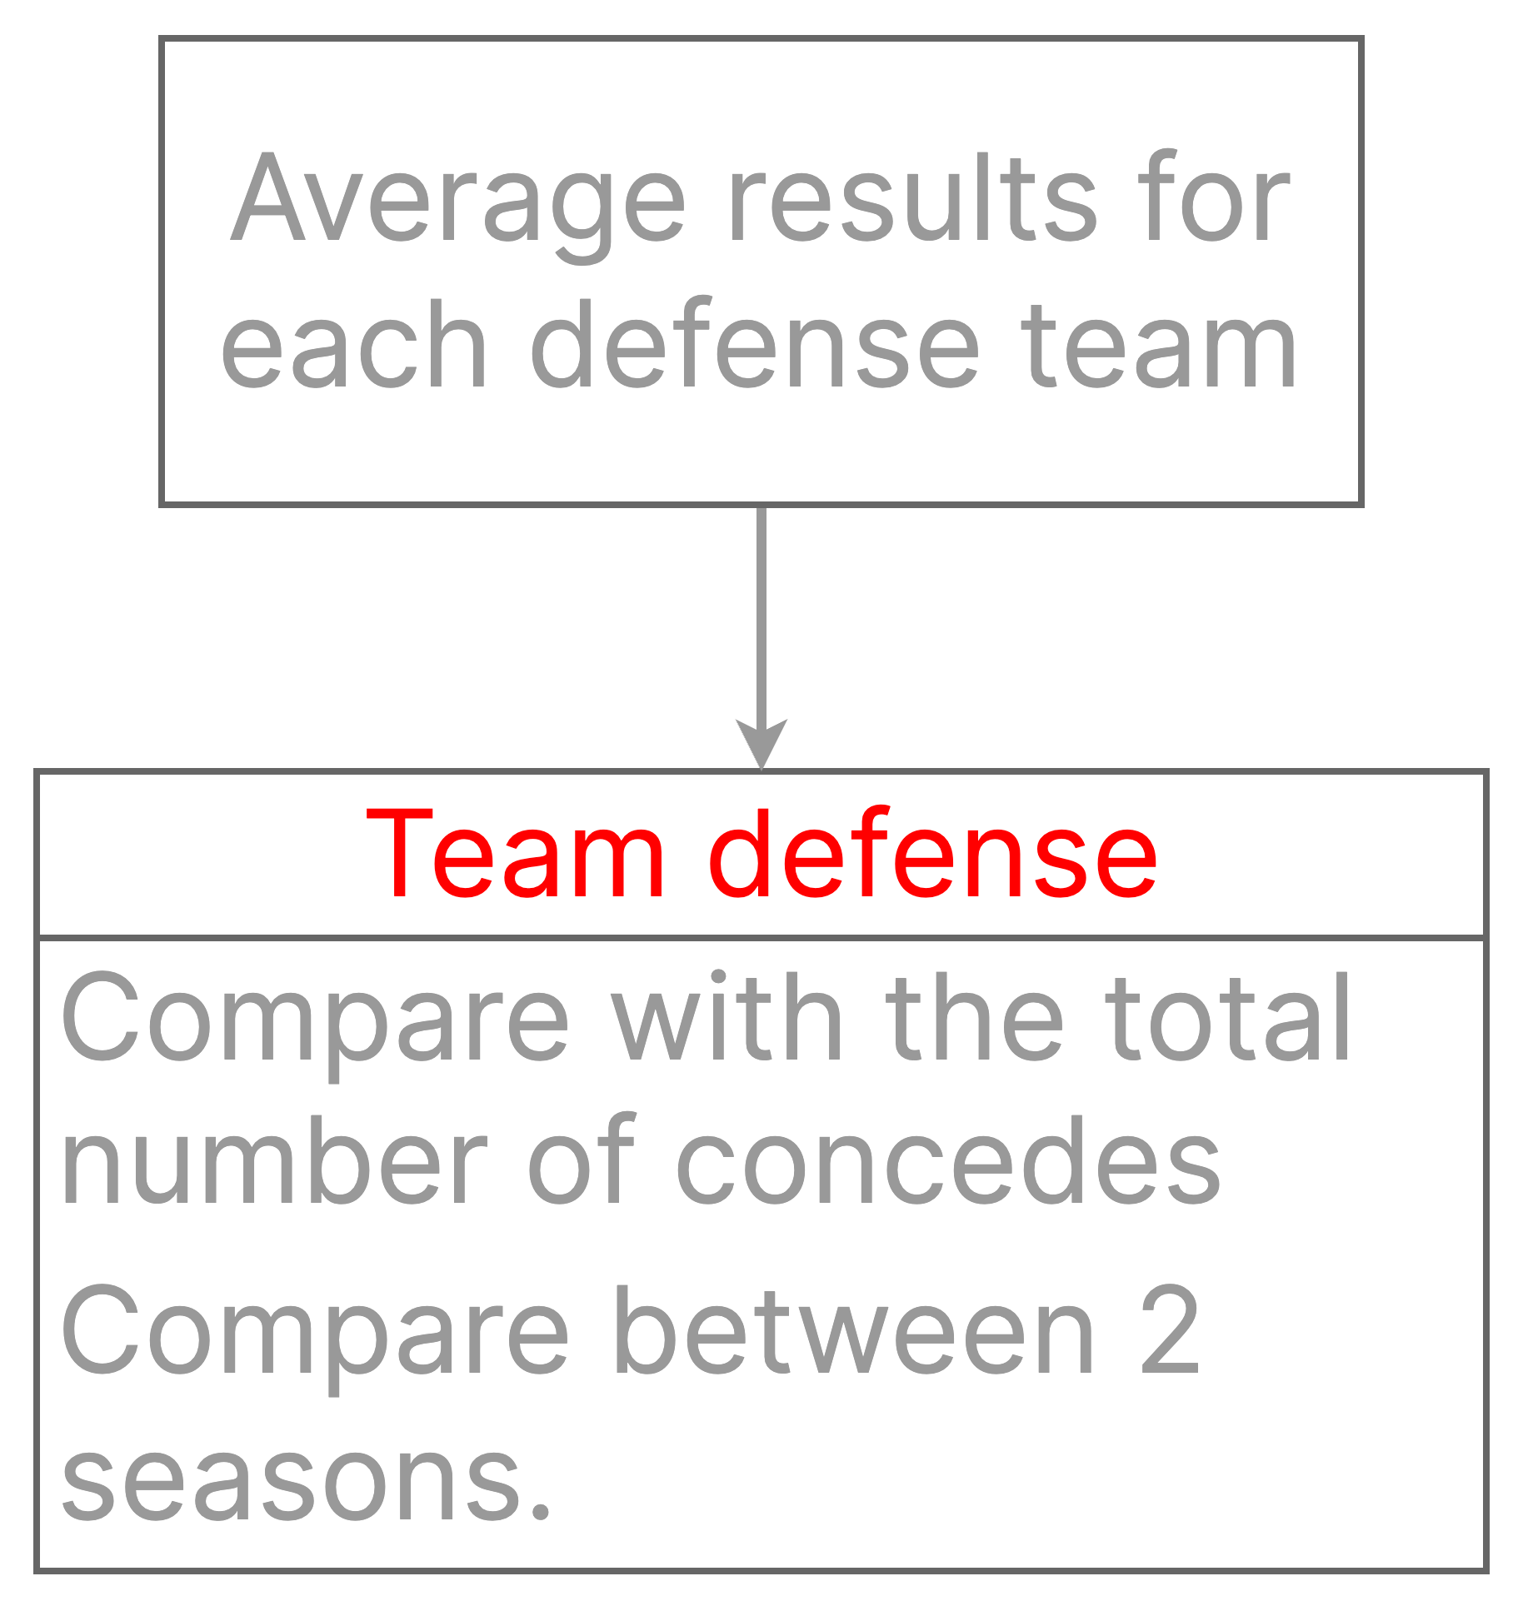
Flowchart of evaluation of team defense with DRSO
Notes:
We first calculated the average results per defense team in the Evaluation.
The target teams were the same ten teams as in the verification.
Next, we used the results of these values to evaluate the teams' defenses in two ways.
The first looked at the relationship with the total number of concessions when playing against the nine other teams.
The other looked at how the games against the other nine teams changed between the 2021-22 and 2022-23 seasons.

Slide 21
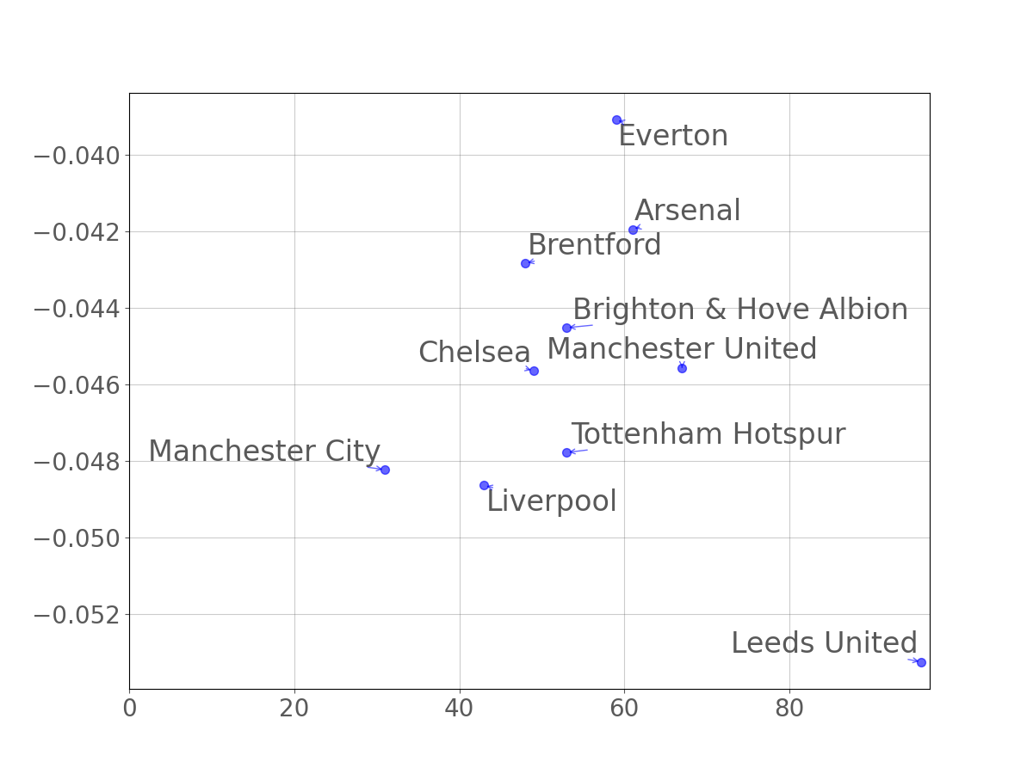
Evaluation Result (1/2)
Diff against the total number of concedes per team.
the difference of EF-OBSO between optimal positioning and orisinal one.
Correlation?
The highest Diff: Everton
but lots of concedes
The lowest Diff: Leeds United
and many concedes
->Additional verification is necessary
Average Diff per defense
The total number of concedes
Notes:
First, showing the relationship between Diff and the total number of concessions below.
The horizontal axis represents the total concessions for each team against the other nine teams, while the vertical axis represents the average Diff between each team.
However, as it is better that with the fewer concessions, the Diff values should be lower as the number of concessions increases.
Therefore, we need additional verification concerning the parameters selected in this study.
Why is the value of the proposed methodology low for Manchester City despite the low number of goals conceded?
We believe that it is either because they are ending their opponents' attacks outside the attacking third or because most of their defending events in the attacking third were when their opponent teams counter-attacked.

Slide 22
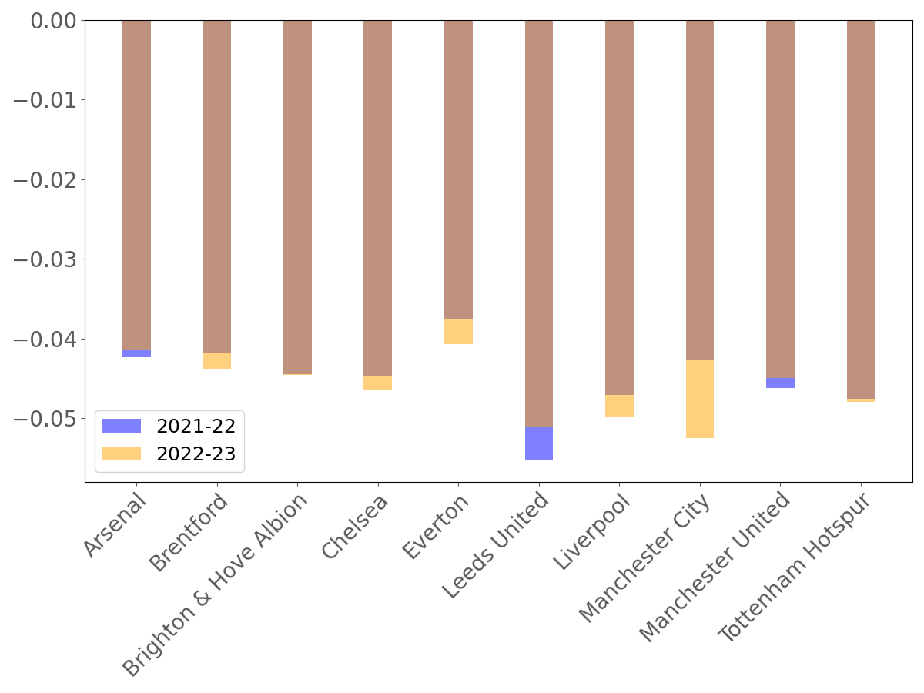
Evaluation Result (2/2)
Diff difference between the 2021-22 and 2022-23 seasons
the difference of EF-OBSO between optimal positioning and orisinal one.
Arsenal, Leeds United etc.
→ Improved defense
Liverpool, Manchester City etc.
→ Worsening defense
Average Diff per defense
event for each season
Able to interpret whether team defense was improving.
Teams
Notes:
Next, we looked at the differences in Diff for the 2 seasons.
The horizontal axis represents teams, while the vertical axis represents the average Diff of each team per season against the other nine teams.
The blue areas represented the 2021-22 season, while the orange areas represented the 2022-23 season.
Using the DRSO, we may be able to interpret the improvement or deterioration of team defenses.
In other words, we found Arsenal and Leeds United have improved their defense against the nine other teams in the next season, as the blue areas are visible.
Conversely, we found Liverpool and Manchester City did not improve their defense against the other nine teams in the next season because the orange areas were visible.

Slide 23
Conclusion
EF-OBSO (Event and Freeze frame data based OBSO)
A method making it possible to compute OBSO even with incomplete data by limiting the range of computation.
→Expect that everyone will use more accessible data and evaluate off-ball players.
DRSO (Defensive Response to Scoring Opportunities)
A method making it possible to compute a defender’s optimal positioning using counterfactuals.
→Expect to be able to support players in their decision-making.
Notes:
In conclusion, we proposed two approaches.
The first is EF-OBSO.
This method may allow us to compute OBSO even with incomplete data by limiting the range of computation.
Using this, we expect everyone to use more accessible data and evaluate off-ball players.
The second is DRSO.
This method may allow us to compute a defender's optimal positioning using counterfactuals.
Using this, we expect to be able to support players in their decision-making.

Slide 24
Future Work
Compare with the case of using complete location data.
As we carried out the verification in this study with incomplete data, it is necessary to compare and verify the results with those with complete data.
Verify the parameters.
The parameters used to calculate EF-OBSO, such as player speed, were artificially determined, so it is necessary to verify them.
Improve the DRSO algorithm.
Grid vertices were not checked if these were realistically attainable, so it is necessary to improve this method.
e.g., A player's possible movement area: a gird -> a circle
Notes:
Finally, we introduce future works.
The first is to compare with the case of using complete location data.
As we verified this study with incomplete data, comparing and verifying the results with those with complete data is necessary.
The second is to verify the parameters.
We set the parameters in this study, such as speed.
However, we determined these artificially, so it is necessary to verify them.
The third is to improve the DRSO algorithm.
In this study, we used grid lattice points to define players‘ counterfactual positions without checking if those were realistically attainable, so it is necessary to improve this method.

Slide 25
Reference (1/2)
[1] Spearman, William. "Beyond expected goals." Proceedings of the 12th MIT sloan sports analytics conference. 2018.
[2] Teranishi, Masakiyo, et al. "Evaluation of creating scoring opportunities for teammates in soccer via trajectory prediction." International Workshop on Machine Learning and Data Mining for Sports Analytics. Cham: Springer Nature Switzerland, 2022.
[3] Llana, Sergio, et al. "The right place at the right time: Advanced off-ball metrics for exploiting an opponent’s spatial weaknesses in soccer." Proceedings of the 14th MIT Sloan Sports Analytics Conference. 2020.
[4] Toda, Kosuke, et al. "Evaluation of soccer team defense based on prediction models of ball recovery and being attacked: A pilot study." Plos one 17.1 (2022): e0263051.
[5] Stöckl, Michael, et al. "Making offensive play predictable-using a graph convolutional network to understand defensive performance in soccer." Proceedings of the 15th MIT sloan sports analytics conference. Vol. 2022. 2021.
[6] Robberechts, Pieter, Maaike Van Roy, and Jesse Davis. "un-xPass: Measuring Soccer Player's Creativity." Proceedings of the 29th ACM SIGKDD Conference on Knowledge Discovery and Data Mining. 2023.
Notes:
Here is the references.

Slide 26
Reference (2/2)
[7] J. Yorke, “StatsBomb 360: Exploring Line Breaking Passes,” StatsBomb | Data Champions, Jun. 28, 2022. https://statsbomb.com/articles/soccer/statsbomb-360-exploring-line-breaking-passes/ (accessed Sep. 4, 2023).
[8] Umemoto, Rikuhei, Kazushi Tsutsui, and Keisuke Fujii. "Location analysis of players in UEFA EURO 2020 and 2022 using generalized valuation of defense by estimating probabilities." arXiv preprint arXiv:2212.00021 (2022).
[9] Furbino Marques do Nascimento, Ricardo, and Hugo MR Rios-Neto. "Generalized Action-based Ball Recovery Model using 360$^\circ $ data." arXiv e-prints (2023): arXiv-2307.

Slide 27





Thank you.
umemoto.rikuhei@g.sp.m.is.nagoya-u.ac.jp
https://rikuhei-ynwa.github.io/
rikuhei-umemoto-ynwa
Rikuhei-ynwa

